Slide 1
SCALABLE ARCHITECTURE TO PROCESS LARGE DATA USING APACHE PARQUET DATA FORMAT
Team Members: CPSC 531 - 03
Vishnu Vardhan Reddy Yeruva - 885174276 Prof. Tseng-Ching Shen
Sri Satya Gopisetty - 885787150

Slide 2
INTRODUCTION
In this project firstly, we are ingesting JSON data into Kinesis Data Streams and converting the data into Apache Parquet Data Format using Amazon Kinesis Data Firehose.
After Conversion, we are storing this data in an S3 Data Lake.
We are querying this stored data using Amazon Athena.
We are analyzing and visualizing this queried data from athena in Tableau.

Slide 3
Why Parquet Format over other Data Formats?
We are converting the data to Parquet format because it is hard to access data from large CSV files, which is not ideal in Big data.
The CSV files require a lot of space when compared to Parquet files. This makes using the CSV format more costly.
Whereas in Parquet format, the data is easy to access and also take up less space.

Slide 4
About Apache Parquet Data Format
Apache Parquet is an optimized columnar data format where each column has a data type it has to follow, which makes it faster to work with because it reduces the need for code that parses data types.
Parquet Data Format requires less space in storage when compared to other types.
This format is not easy for humans to read. We have to use code or special file viewers to read the parquet data.

Slide 5
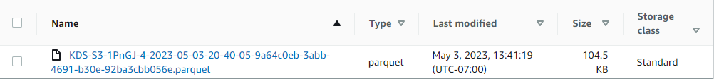
Parquet File
CSV File
Here we can see a clear difference between the file sizes of the same in Parquet format and CSV Format.

Slide 6
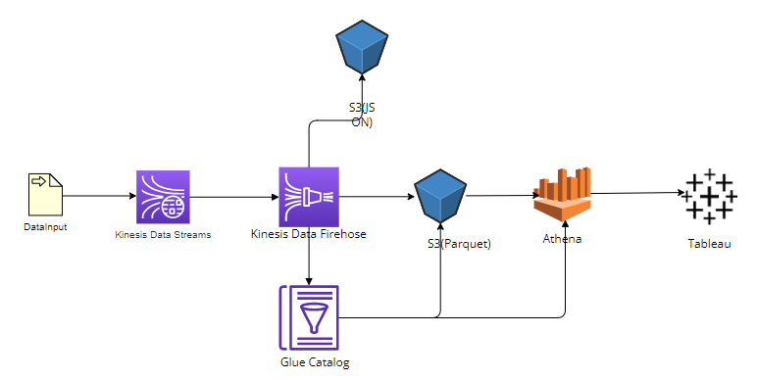
ARCHITECTURE

Slide 7
Technologies Used
AWS Kinesis Data Streams.
AWS Kinesis Data Firehose.
AWS Glue Data Catalog.
Amazon S3.
Amazon Athena.
Tableau.

Slide 8

AWS Kinesis Data Streams
Kinesis Data Streams focuses in ingesting and storing data streams.
In our project, we are using this tool to capture the ingested data quickly.
This captured data has been ingested to Kinesis Data Firehose.

Slide 9
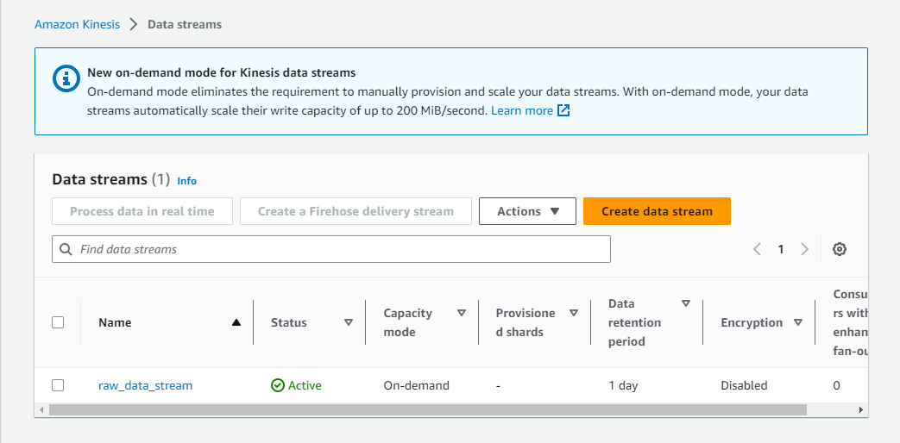

Slide 10

AWS Kinesis Data Firehose
Firehose is an extract, transform and load (ETL) service that captures, transforms and sends streaming data to data storages.
In our project, we are using this technology to capture JSON data from data streams and transform this data into Parquet Data Format using Glue Catalog.
This Parquet Data will be ingested to S3 Data Lake.

Slide 11
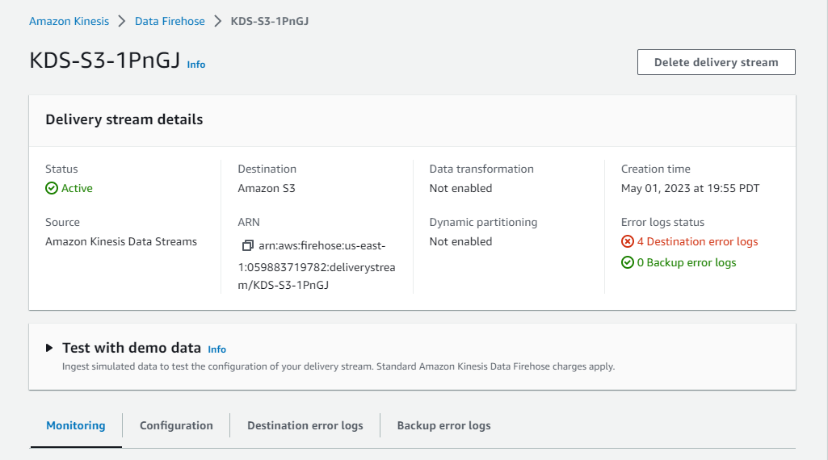

Slide 12

AWS Glue Data Catalog
Glue Data Catalog provides a unified interface to store and query information about data formats, schemas, and sources.
In our project, we are using this technology to define the schema of the parquet data. Firehose, S3, and Athena use this schema to process, store, and query the parquet data.

Slide 13
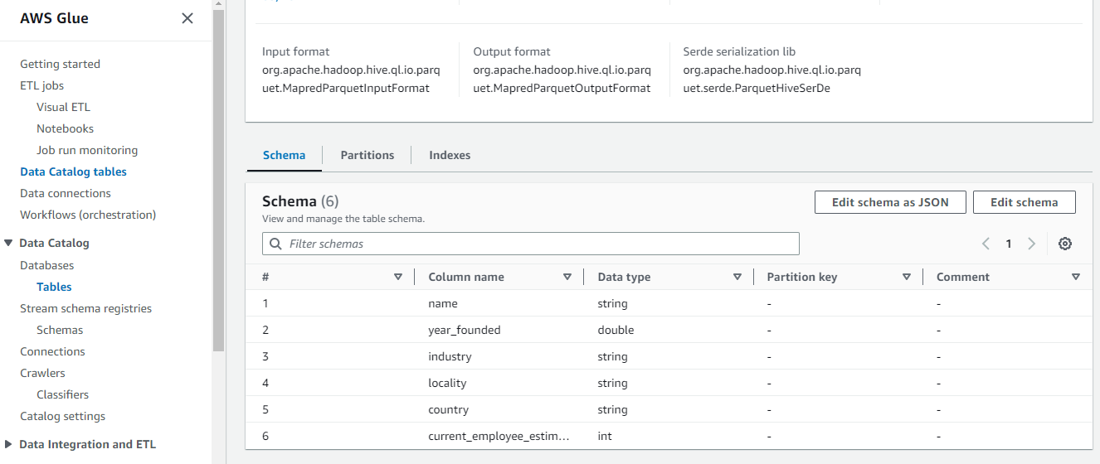

Slide 14

Amazon S3
Amazon S3 is an object storage service that is used to store and retrieve any amount of data.
In our project, we are using S3 to store the parquet data from firehose.
We are using 3 S3 buckets.
apaparquetstorage.
databackups3.
aaquerytables.

Slide 15
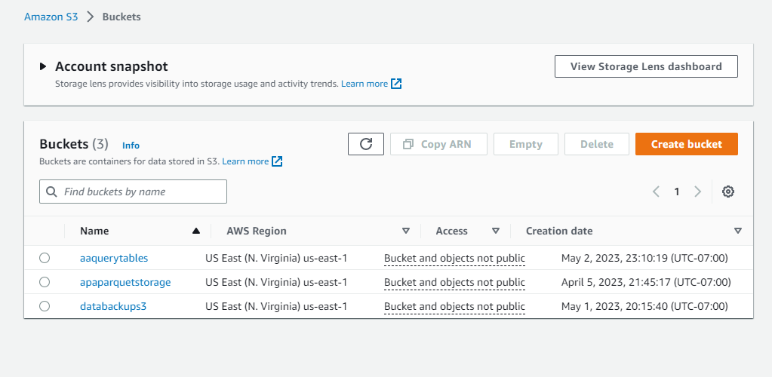

Slide 16

Amazon Athena
Athena is used to run ad-hoc queries using ANSI-SQL.
In our project, we are using athena to query the data from the S3.

Slide 17
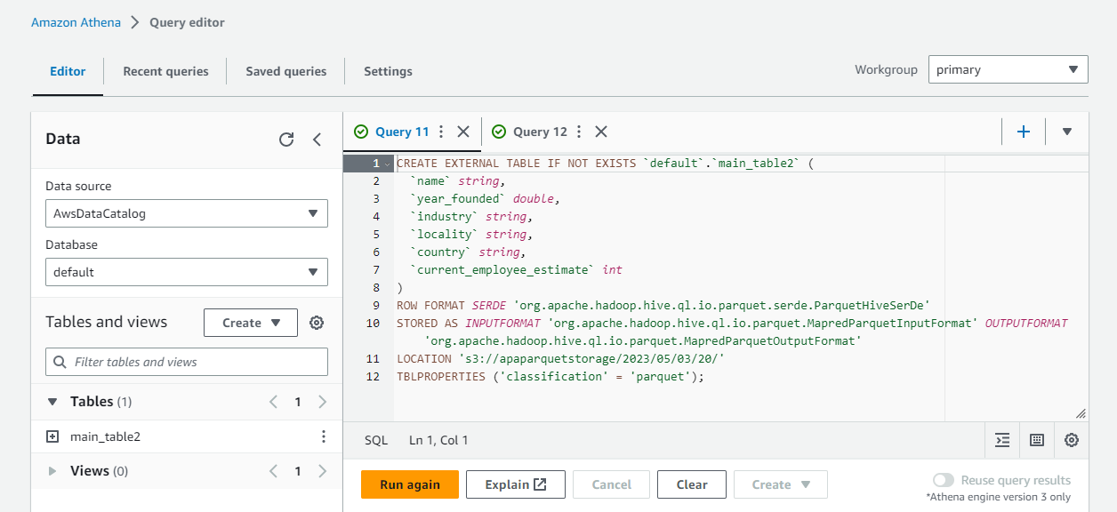

Slide 18

Tableau
Tableau is a data visualization tool which has the ability to develop comprehensive, interactive workbooks and dashboards.
In our project, we are using tableau to visualize our data and analyze the visualized data to get to know some characteristics and insights of the data.

Slide 19
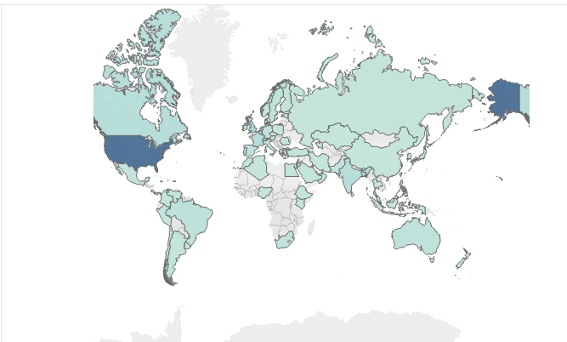
Data Visualization of number of companies originated from various countries

Slide 20
THANK YOU!

